Slide 1
Employee Performance Analysis Using Excel
PRESENTED BY: BHUVANESHWARAN N
REGISTER NO.: 312206906
DEPARTMENT: COMMERCE
COLLEGE: K.C.S KASI NADAR COLLEGE OF ARTS AND SCIENCE

Slide 2
PROJECT TITLE
Employee Performance Analysis Using Excel

Slide 3
AGENDA
1.Problem Statement
2. Project Overview
3.End Users
4.Our Solution and Proposition
5. Dataset Description
6. Modelling Approach
7. Results and Discussion
8.Conclusion

Slide 4
PROBLEM STATEMENT
Identify and report any discrepancies or inconsistencies between the calculated distributions and the given totals.
Verify that the distribution of scores you calculate is consistent with the given category totals
Ensure that the sum of scores in each category adds up to the provided category totals.
Despite seasonal fluctuations, overall sales growth has stagnated over the past year
The pivot graph reveals untapped sales potential in certain regions and product categories

Slide 5
PROJECT OVERVIEW
[Employee Performance Improvement and Pay Zone Optimization]
Monitor and evaluate sales performance to ensure growth and expansion
Develop and implement targeted sales strategies to optimize product offerings, resource allocation, and marketing initiatives
Visualizing Employee Attendance Trends with Excel Charts
Using Pivot Tables for Employee Turnover Analysis
Allocate each employee’s total score to the categories: "Exceeds," "Fully Meets," and "Needs Improvement."

Slide 6
WHO ARE THE END USERS?
Human Resources (HR) Department
Department Managers (Sales & Production)
Senior Leadership/Executives
Employees
Finance/Compensation Teams

Slide 7
OUR SOLUTION AND ITS VALUE PROPOSITION
Filtering - Remove missing values.
Conditional Formatting - Blanks, Background Color Shading, Data Bars, Values.
Data Filtering and Sorting - Identify specific employee performance groups, such as those with exceeds, needs improvement and fully meets.
Pivot table - Summary of employee performance under their employee Id.
Graphs - Final Report with Trend line.

Slide 8
DATASET DESCRIPTION
EMPLOYEE ID: Unique identifier for each employee in the organization.
FIRST NAME: The first name of the employee.
PAY ZONE: The pay zone or salary band to which the employee's compensation falls.
DEPARTMENT TYPE: The broader category or type of department the employee's work is associated with.
CURRENT EMPLOYEE RATING: The current rating or evaluation of the employee's overall performance.

Slide 9
MODELLING
DATA SET: Kaggle, Employee dataset.
FEATURE SELECTION: Slicer, Conditional Formatting, Designing.
DATA CLEANING: Missing values, Irrelevant data, Correct Errors, Remove Unnecessary Columns and Rows.
PIVOT TABLE: Employee ID, First Name, Performance Score.
CHART: Report of Employee Performance based on their Employee Id is represent in Values and Performance Score presented as Column Chart.

Slide 10
RESULTS

Slide 11
CONCLUSION
The project focuses on improving employee performance and aligning compensation through data analysis and strategic interventions. Using Excel as a primary tool provides an accessible, cost-effective, and flexible solution for analyzing employee performance, Pay Zones, and departmental efficiency.
By identifying performance gaps, creating targeted improvement plans, and adjusting compensation strategies, the company can:
Boost overall productivity.
Increase employee satisfaction and retention.-
Ensure fair and equitable compensation across Pay Zones.
This framework provides a structured approach to sales performance optimization, enabling businesses to unlock significant revenue growth, improve sales efficiency, and achieve sustainable success.

Slide 12
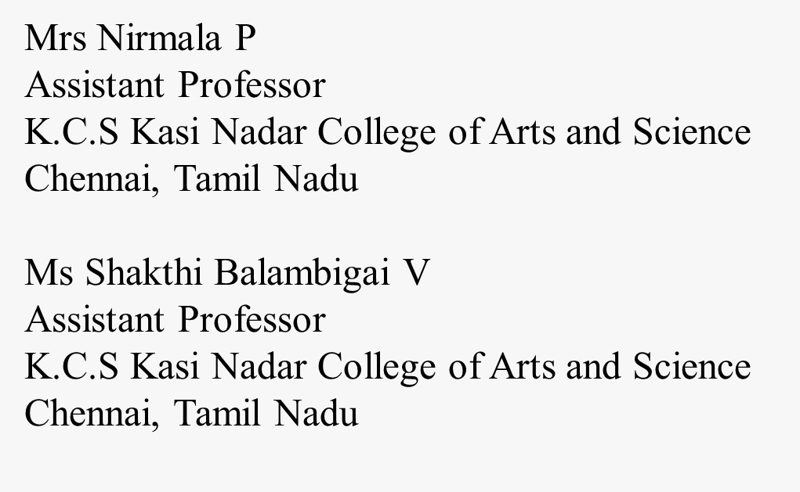
REFERENCE

